Slide 1
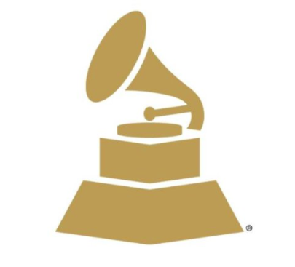
And the Winner Is...
Team 5
Jenny Chin, Rommel Angeles, Gar Cheuy, and Melvin Garcia

Slide 2
Agenda
Introduction and Motivation
Process and Data Exploration
Assumptions and Limitations
Trends
Conclusion

Slide 3
Introduction
Utilize the Youtube API to ‘predict’ the 2018 Grammy Winners for:
Record of the Year
Song of the Year
Best New Artist
Obtained data for Grammy nominees from the last 10 years (2008-2018)
Are there any data correlation between YouTube popularity metrics and Grammy Award winners?
Are there any data correlation between sentiment analysis of YouTube comment threads and Grammy Award winners?

Slide 4
Motivations
We’re all music lovers!
Many people try to predict grammy winners, but we wanted to take a data-driven approach
The 2018 Grammys are just around the corner (Jan. 28, 2018)
Originally wanted to use Spotify API, but based on its limitations on the data we can retrieve we decided to use the Youtube and its breadth of available data

Slide 5
Process
Search and organize dataframe by artist name and/or song title per category
Obtain view count, like count, and dislike statistics per video and official artist channels in the time frame the song and/or artist was eligible for their grammy nomination
e.g. For 2016 Grammy awards, a song and/or artist is eligible when released between Oct. 1, 2015 and Sept. 30, 2016
Per video, obtain comment thread and perform VADER sentiment analysis
We applied the weighted score by applying 50% on view counts and 50% on like counts.
From the data, we plotted bar graphs on the weighted score per category and marked the winners as red and the rest as blue

Slide 6
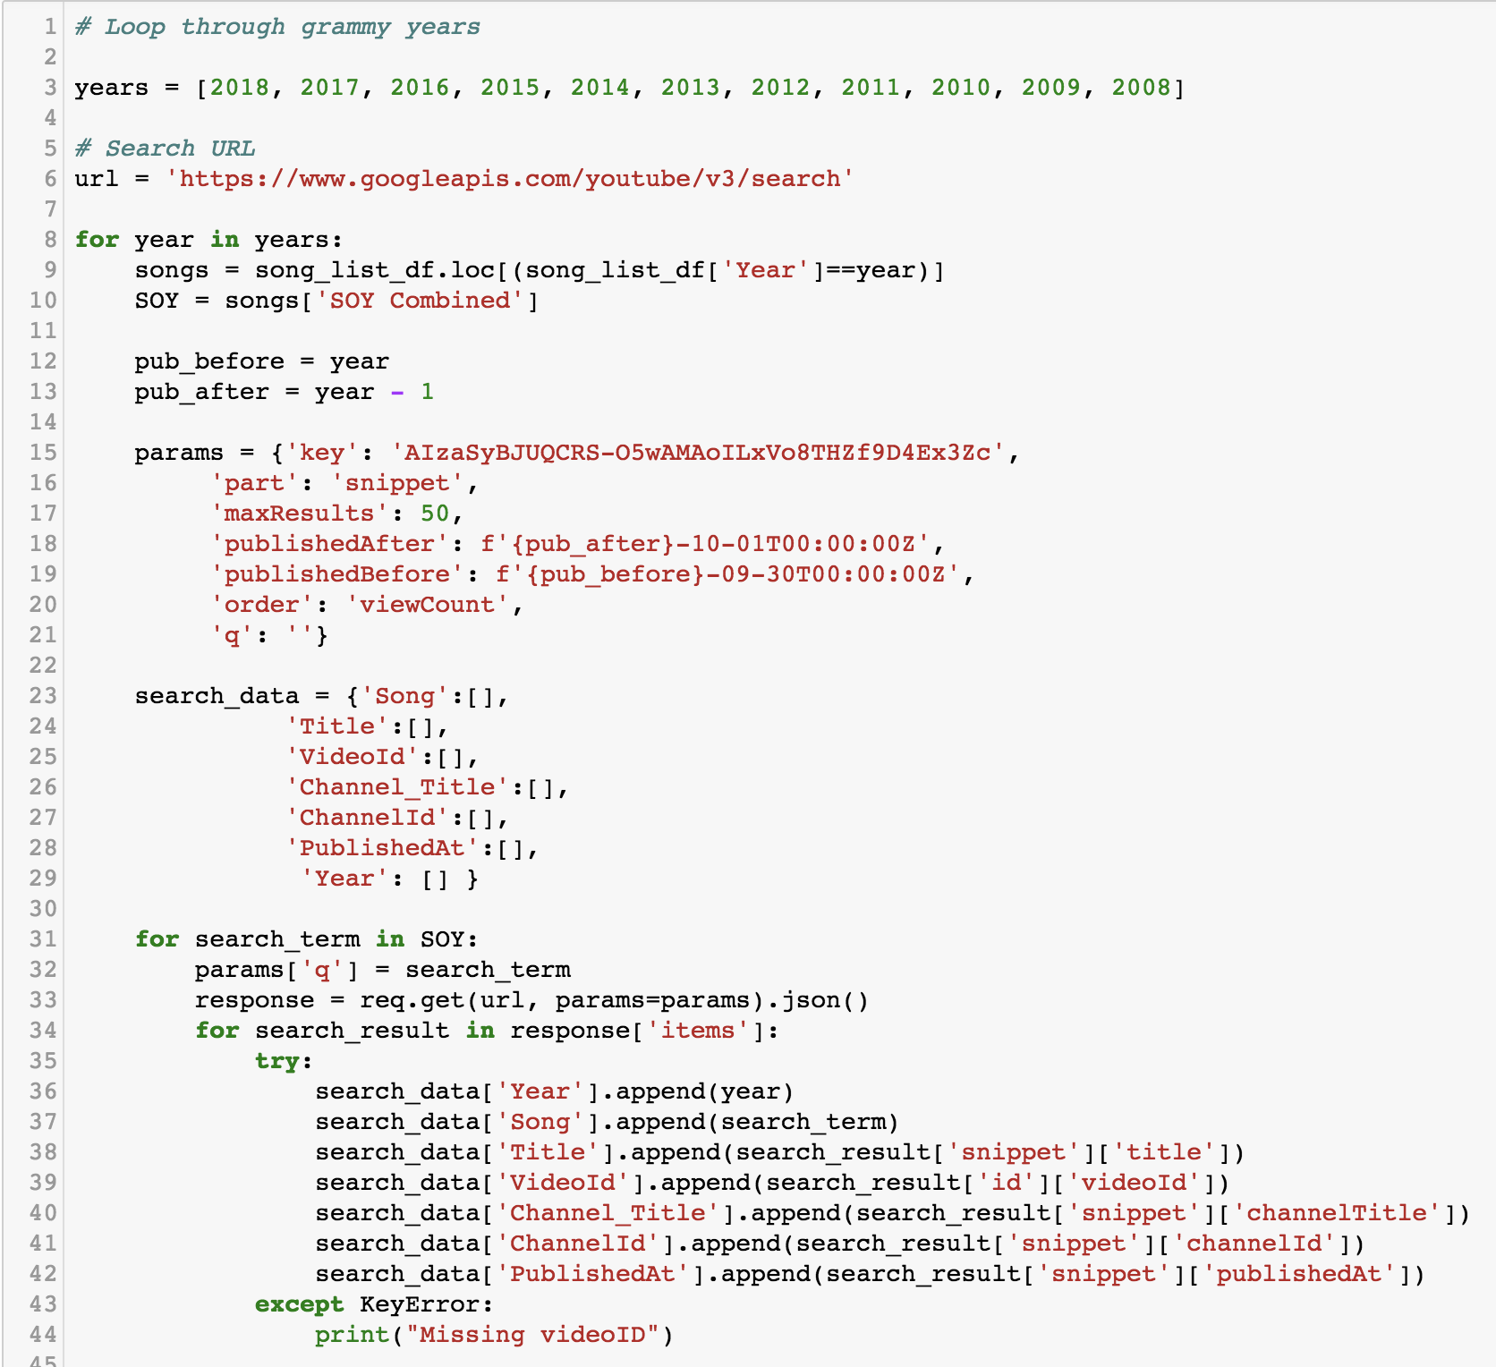
Data Exploration and Clean-up
← Build search list per year
← Set parameters to obtain videos uploaded during grammy eligibility period
← Loop through search terms based on song, artist query

Slide 7
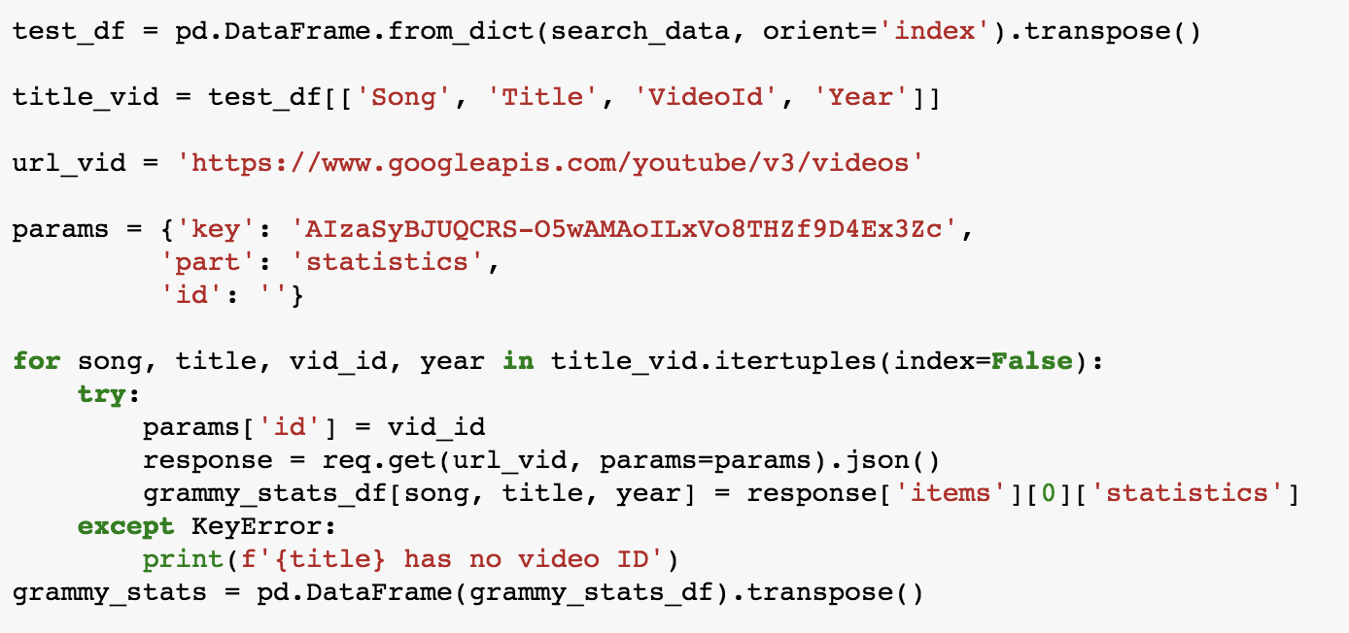
Data Exploration and Clean-up cont.
← Loop through obtained videoIds in first loop to obtain statistics: ‘likeCount’ and ‘viewCount’

Slide 8
Limitations
View counts and like counts are cumulative totals from the time of video upload to today, and not just counts accumulated during their grammy eligibility periods
Video content may also contribute to the number of view and like counts, and not solely from audio content
Hard to filter for official videos only
Parodies, covers, lyric/fan made videos
Difficult for VADER to interpret slangs in comments
e.g. “This track is fire” receives a compounded score of 0.005
Can’t interpret emojis or comments written in foreign languages

Slide 9
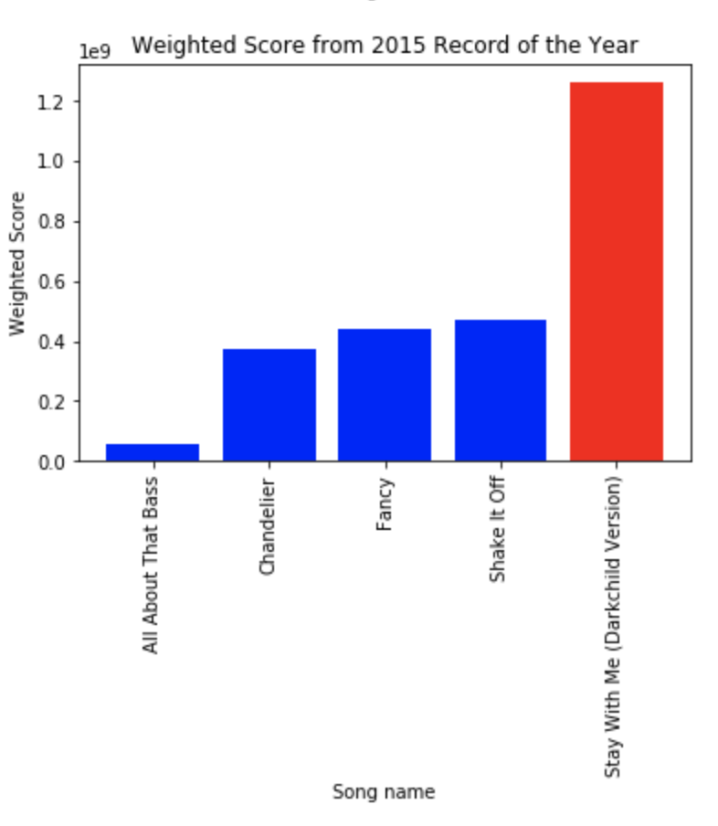
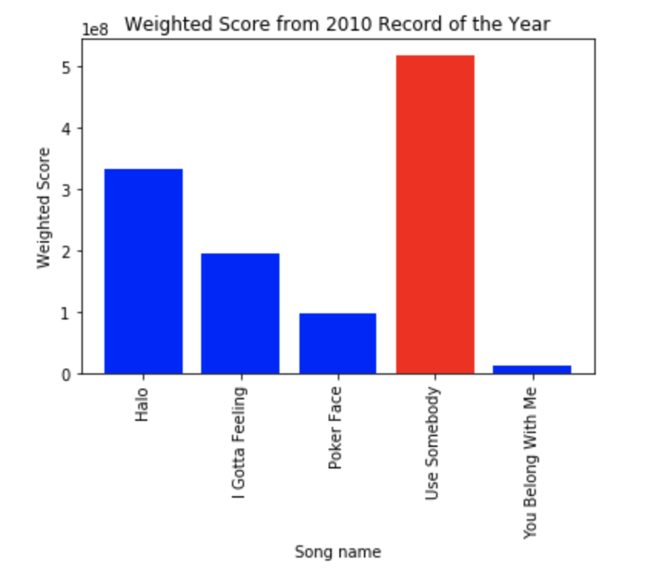
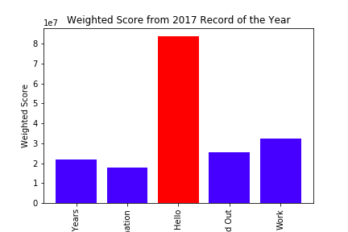
Data and Trends
Record of the Year

Slide 10
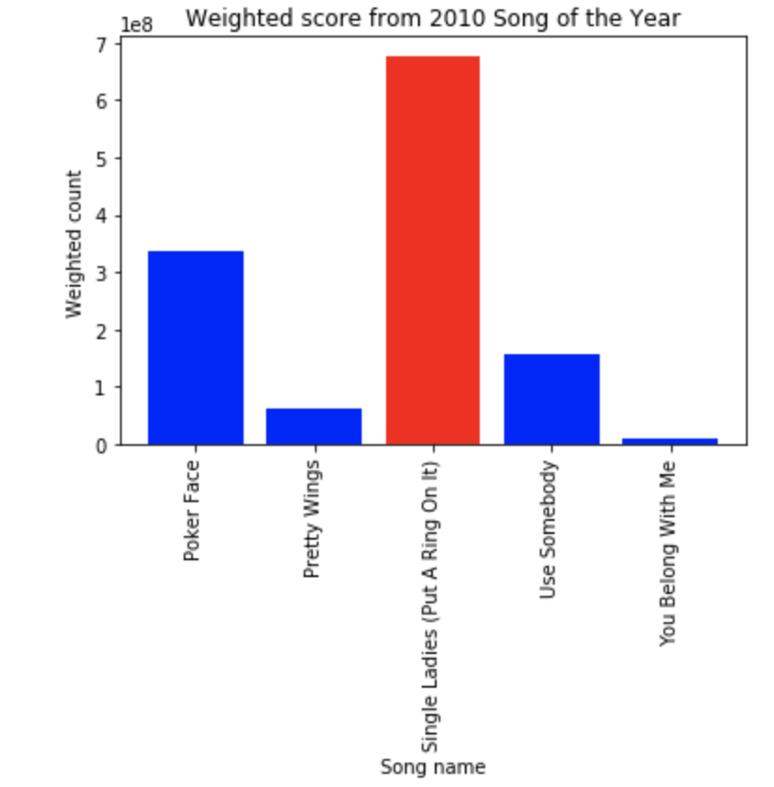
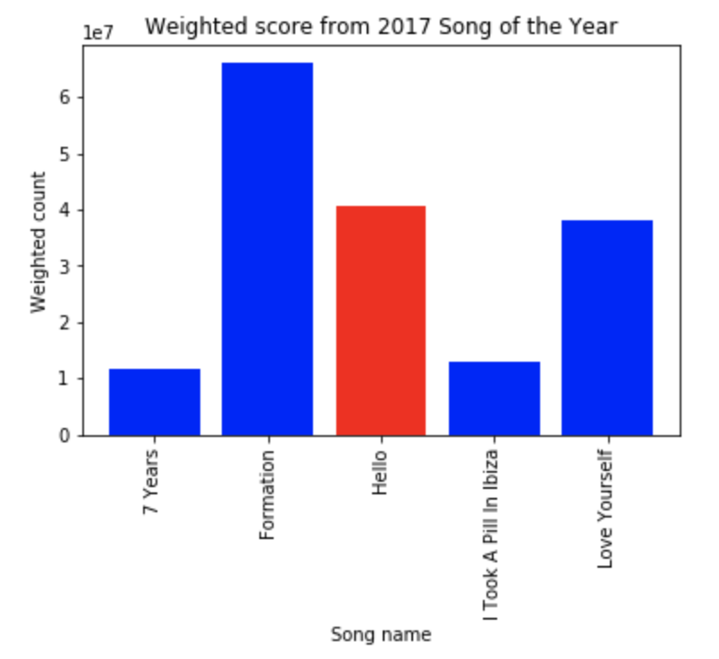
Data and Trends
Song of the Year

Slide 11
Data and Trends
Song of the Year (Vader Analysis)

Slide 12
Data and Trends
New Artist of the Year

Slide 13
Data and Trends
There seems to be no correlation between YouTube view counts and like counts as it pertains to Grammy winners. For ROY, the winners matched the YouTube data in 3 of the last 10 years.
There also seems to be no correlation between YouTube video comments and Grammy winners. For SOY, the winners matched the YouTube comment sentiment data 2 out of 10 years (2008 and 2012).
We looked for patterns that contribute to higher view counts and like counts in YouTube and they are inconclusive. Examples are songs with multiple artists, genre of music, etc.

Slide 14
2018 Nominees and Data

Slide 15
Conclusion
Since there is no clear correlation between YouTube data and past Grammy Winners, we are unable to predict the winners for next year. And the winner is….and this is just a guess
Record of the Year - Redbone by Childish Gambino
Song of the Year - Despacito by Luis Fonsi feat. Justin Bieber
New Artist of the Year - SZA

Slide 16
Conclusion cont.
What we could explore more or do differently
Obtain data if users have saved certain songs/artists to their personal playlists and use as additional parameter
Implement stricter filters so that our search results actually pertain to the song/artist
Answer the question of how having a featured artist may affect the number of views and like compared to the original artist’s other songs w/o featured artist
Conduct VADER sentiment analysis on lyrics of songs and determine a compound score threshold that could divide happy and sad songs ?

